Slide 1
SIT374: Project Management
Lecture 1
Project and Project Management

Slide 2


Resources
Information Technology Project Management 6th-8th edition, by Kathy Schwalbe
Project Management Body of Knowledge (PMBOK 6th edition)
Chinese textbooks (e.g., Chinese version of PMBOK for important concepts)

Slide 3
What are to be delivered
Content knowledge
Key terminologies
Processes and methods
Fundamental calculations
Activities
Reflection on past experiences
Case studies

Slide 4
Activity 1
What discipline-related units/subjects have you learned before?
Have you applied the knowledge/skills gained in solving real-world problems/achieving higher level goals?

Slide 5
Project…

Slide 6
What is a Project?
A temporary endeavor undertaken to create a unique product, service or result. PMBOK 6th edition
Project Attributes:
Time frame
Purpose
Ownership
Resources
Roles
Risks
Project Activity | Normal Operation
Start-end | Repetitive
Unique | Standard/Same
Temporary | On-going
High risk | Known risk
Project management | Process management
vs

Slide 7
Activity 2
Try to identify the LARGEST project each of you have been involved with.
You don’t have to be the project manager – if not, what was your role? (team member, developer, analyst?)
How the project you have identified meets the criteria:
Unique
Temporary

Slide 8


Some example projects by Deakin students in capstone
DataByte
ThothTech

Slide 9
Project success
Traditionally: meet project objectives – delivers the promised scope on time, within budget…
More effective measure: satisfied customer

Slide 10
Project Failure
IT and many other disciplines have a terrible track record of meeting project objectives
Volkswagen cheated government emission testing
Nissan Airbag glitch
Why Projects Fail?
X Over budget
X Behind Schedule
X Outsourcing problems
X Quality problem

Slide 11
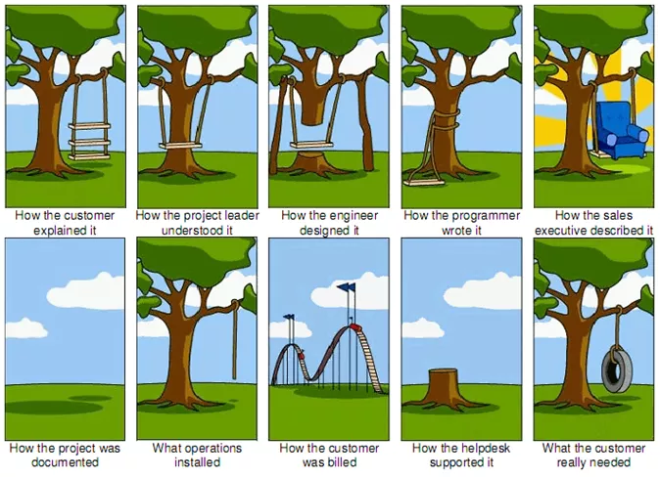
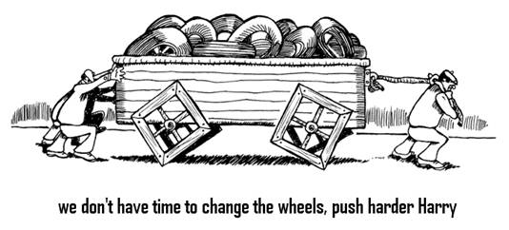
Activity: What do you think Could Be the problem?

Slide 12
Project Success & Failure Factors
Executive support
User involvement
Experienced managers
Clear business objectives
Minimized scope
Standard software infrastructure
Firm basic requirements
Formal methodology
Reliable estimates
Small milestones
Proper planning
Competent staff and ownership

Slide 13
Project Triple Constraints
All the constraints can be grouped into these three:
Cost
Time
Quality
Scope

Slide 14
Activity 3 – How to approach a project
You are part of a software development team tasked with creating a new web-based application for a client within a limited budget and tight deadline. The client's requirements are extensive, including numerous features and functionalities.
How would you approach this project under the given constraints?

Slide 15
Project Management…

Slide 16
What is Project Management?
The application of knowledge, skills, tools and techniques to project activities to meet project requirements.
A set of structured and systematic best practices to have a successful project.

Slide 17
Why is Project Management important?
Technology and the use of interdisciplinary and global work teams have radically changed the work environment
The U.S spends $2.3 trillion on projects every year --- one-quarter of its gross domestic product
The world as a whole spends nearly $10 trillion of its $40.7 trillion gross product on projects of all kinds.
Standish Group Chaos Report – surveyed 50,000 projects in 2015
29% – Successful
19% - Failed
52% - Challenged
Improve the likelihood of success!

Slide 18
More on the benefits
Project level
Efficiently manage project constraints
Balance the influence of project constraints
Identify, recover or terminate failing projects
Organization level
Optimize the use of organizational resources
Compete more effectively in the markets
Sustain the organization

Slide 19
Why learn project management
Gaining knowledge and skills in multiple areas
Understanding project lifecycle/management processes
Scope/time/cost management…
Communication
Adaptability and flexibility
Career advancement
Leadership roles

Slide 20



History of project management
Ancient times
Early methodologies not well-documented, but results still stand: the pyramids, Stonehenge, mass human migrations

Slide 21
History of project management (continued)
Late 19th century
Construction of intercontinental road, other large projects
Early 20th century
Frederick Taylor created Scientific Management of industrial processes
Henry Gantt developed a bar-chart approach to illustrating timing of project tasks and progress

Slide 22
History of project management (continued)
Mid-20th century
CPM and PERT methodologies identified the importance of task sequences/dependencies and the concept of critical path
Project Management as a profession
Project Management Institute (PMI) was found
Project Management Body of Knowledge (PMBOK) was created

Slide 23
History of project management (continued)
Today
Increasing recognition of project management as a specialized set of skills applicable to different industries
Project Management certifications: PMP, CAPM
PMBOK is in its 7th edition
Variation on methodologies:
Phased (waterfall approach)
Agile methods
The importance of integrating projects into portfolios and programs

Slide 24
Project Stakeholders
People involved in or affected by project activities, include:
Project sponsor
Project manager
Project team
Support staff
Customers
Users
Suppliers
Opponents to the project

Slide 25
Activity 4
What it takes to be a successful project manager?
Skills
Knowledge
Attributes

Slide 26
The role of the project manager (Project management expertise)
Technical project management
Knowledge areas
Leadership
Communication, influence, motivation, negotiation and problem solving
Business and strategic management
Knowledge and expertise in industry that better delivers business outcomes

Slide 27
Knowledge Areas
Scope
Time
Cost
Quality
Integration
HR
Comm.
Procure.
Risk
Stakeholder

Slide 28
Project vs. Program vs. Portfolio
Program: A group of related projects managed in a coordinated way to obtain benefits and control not available from managing them individually.
A program manager provides leadership and directions to project managers heading the projects within the program.
A portfolio is a collection of projects and programs that are grouped together to facilitate effective management to meet the strategic business objectives.
Portfolio manager needs to understand how projects fit into the bigger picture of the organization (strategy, finance, risks)

Slide 29
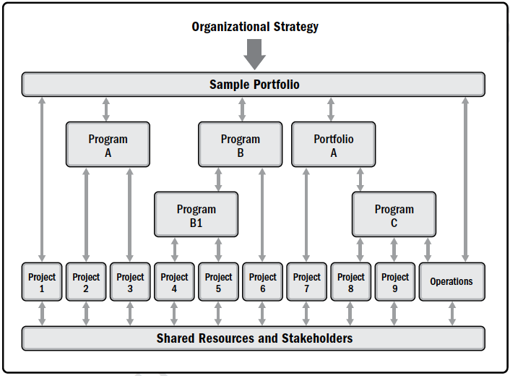
Project vs. Program vs. Portfolio

Slide 30
Project vs. Program vs. Portfolio
Deakin
Teaching & Learning
Research & Innovatoin
Industry and Community
Deakin Online
Office 365
Deakin LMS
Deakin Sync
Cancer treatment
Deakin 2020
Project A
Project B
Project A
Project B
…
…

Slide 31
Project phases, life cycles and management processes …

Slide 32
Project phases
Project deliverable: any unique and verifiable product, result, or capability to perform a service that is required to be produced to complete a phase or project.
Project phase: a collections of logically related project activities that culminate the completion of deliverables
Examples include feasibility analysis, design, build, test, deploy, close
Project gate: is held at the end of each phase
Project performance will be examined.
A decision (continue, repeat, end) will be made.

Slide 33
Project Life Cycle VS. systems development life cycle
Project life cycle (PLC): A group of logical phases/stages that maps the life of a project from its beginning to its end.
The goals are to define, build and deliver the product of a project.
Make the project more manageable and reduce risk.
Deliverables, achieved at milestone points, are tangible and verifiable.
Systems development life cycle (SDLC): Most common product life cycle in IT
PLC deals with the process of managing a (general) project.
SDLC focuses on the creation of IT products.
SDLC can be part of PLC.

Slide 34
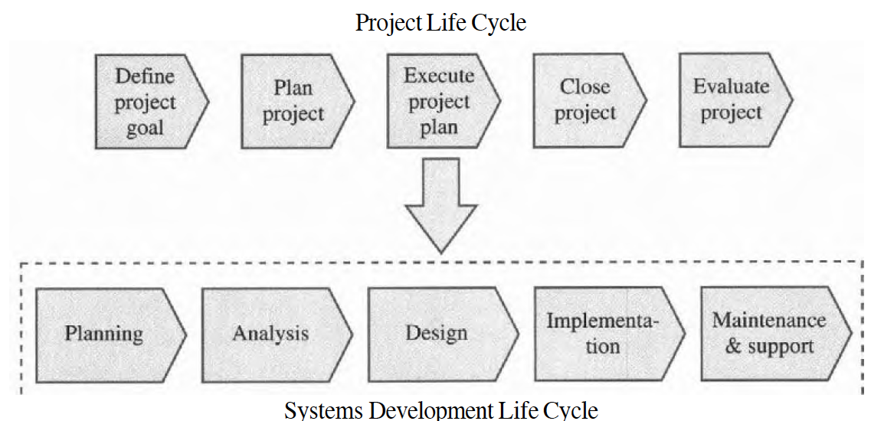
PLC VS. SDLC

Slide 35
Classification of SDLC models
Predictive (waterfall) model: The scope can be clearly articulated, and the time/cost can be accurately predicted.
Each phase is performed once
A large proportion of efforts would be spent to clarify requirements.
A working software may not be seen over an extended period of time.
Adaptive software development model (ASD): Software development follows an adaptive approach.
Iterative and incremental.
More freedom is allowed.
Applicable when requirements are subject to high level of uncertainty.
Agile software development model: Focus on close collaboration between programing team and business experts.

Slide 36
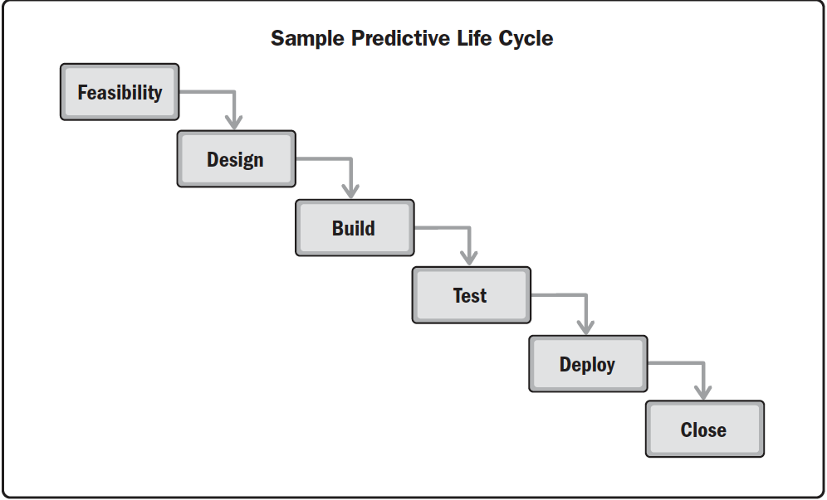
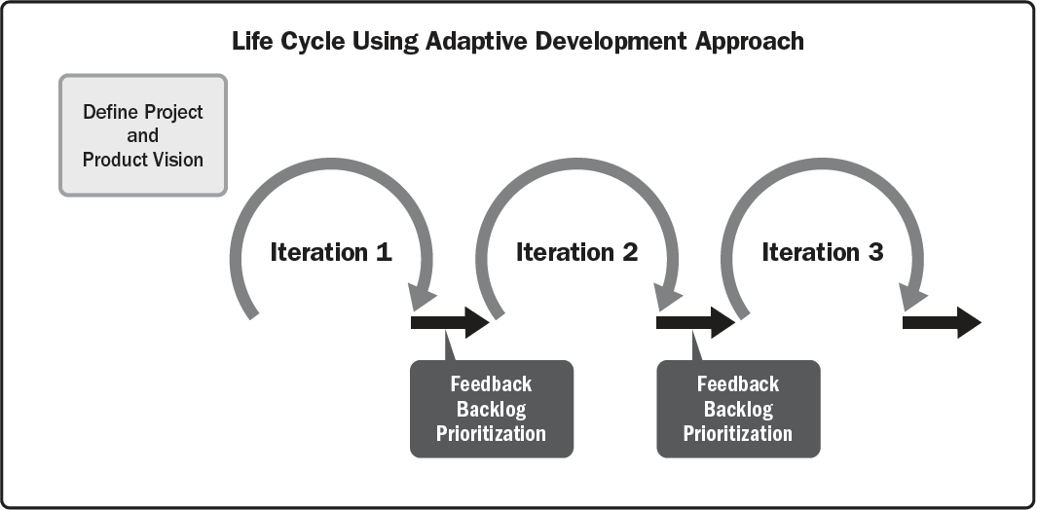
Predictive VS. Adaptive

Slide 37
Activity 5
Pros and cons of each SDLC? When should we use one over the other?

Slide 38
Project management process groups
Process is a series of actions towards a particular result.
Project Management Process Groups consist of
Initiating Process group - Defining and authorizing a project or project phase
Planning Process group - Prepare various plans (Scope, schedule, cost). Revise the plans in each phase of the project
Executing Process group - carry out plans, coordination, produce products/service and results
Monitoring and controlling Process group - measure the progress against the plans and take corrective actions
Closing Process group - Formalizing acceptance of the project or project phase, ending it efficiently
You can apply Process Groups to each phase of the project or apply it to the entire project.

Slide 39
Project management process groups
Approved Project Management Plan
Completion Report
Monitoring
Initiation
Planning
Executing
Closing
Control
Approved Project Charter
Customer signoff

Slide 40
Activity 6
What are the differences between PLC, SDLC, and project management process groups?

Slide 41
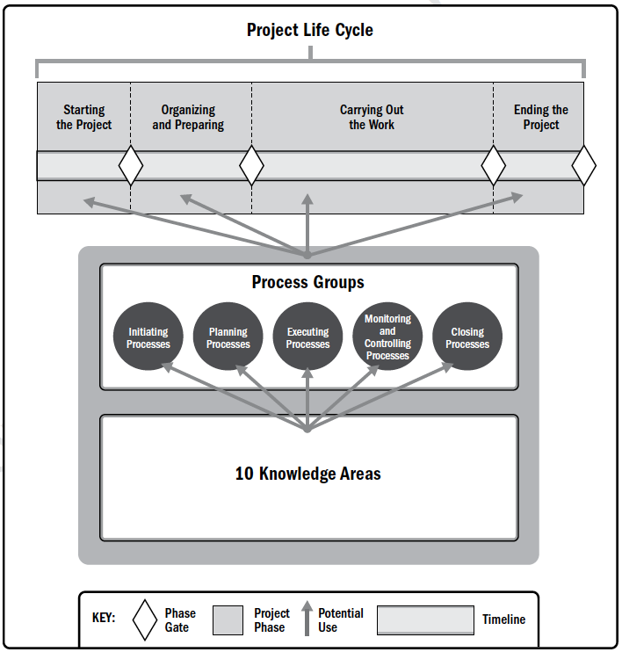
PLC, management process groups and knowledge areas

Slide 42
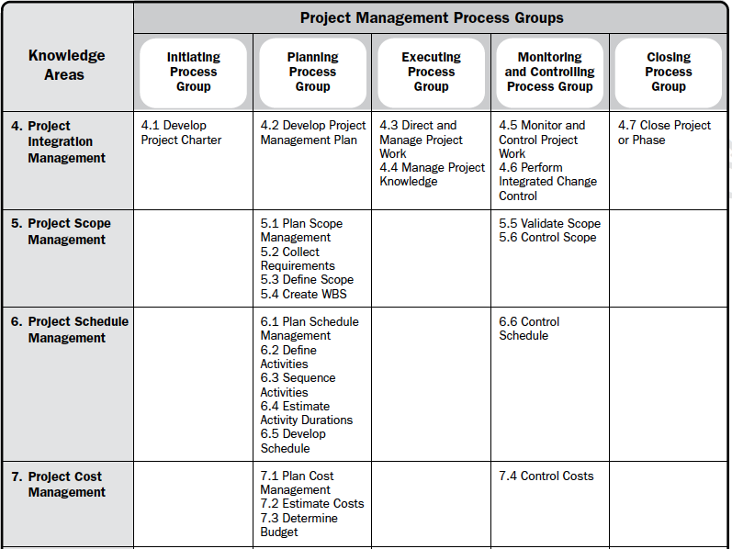
Process groups and knowledge areas mapping

Slide 43
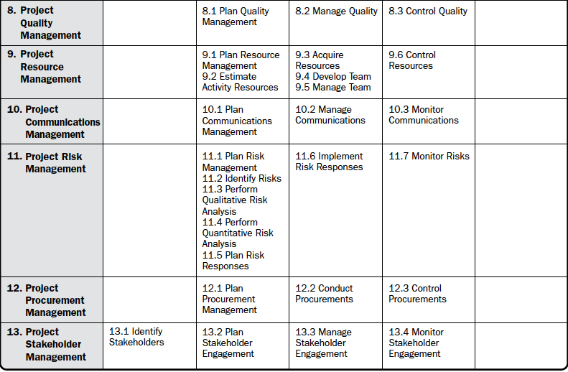
Process groups and knowledge areas mapping

Slide 44
Summary
Project overview
What is a project
Project constraints
Project management overview
What is project management and why
Project management expertise
Project life cycle and management processes
PLC and SDLC
Management process groups

Slide 45
What is next
We will be inspecting the knowledge areas against the (activities in) project management process groups.

